Slide 1
R Programming

Slide 2
R Programming
Programming language and software environment for statistical analysis, graphics representation and reporting.
Freely available under the GNU General Public License.
Pre-compiled binary versions are provided for various operating systems like Linux, Windows and Mac.
R was created by Ross Ihaka and Robert Gentleman at the University of Auckland, New Zealand.
An interpreted computer language which allows branching and looping as well as modular programming using functions.
Allows integration with the procedures written in the C, C++, .Net, Python or FORTRAN languages for efficiency.

Slide 3
Features of R Programming
R is a well-developed, simple and effective programming language which includes conditionals, loops, user defined recursive functions and input and output facilities.
R has an effective data handling and storage facility.
R provides a suite of operators for calculations on arrays, lists, vectors and matrices.
R provides a large, coherent and integrated collection of tools for data analysis.
R provides graphical facilities for data analysis

Slide 4
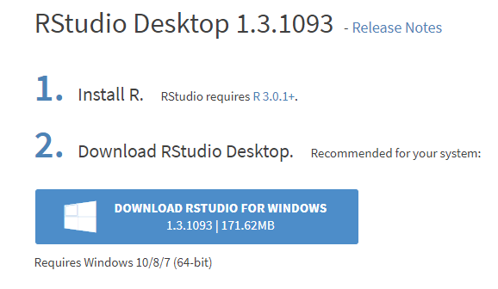
Installing R
For Windows
https://rstudio.com/products/rstudio/download/
For Linux
$ yum install R

Slide 5
Basic “Hello World” Program
# My first program in R Programming
s1<- "Hello, World!"
print ( s1)

Slide 6
Variables in R
Variables are not declared as some data type.
Variables are assigned with R-Objects and the data type of the R-object becomes the data type of the variable.
types of R-objects
Vectors
Lists
Matrices
Arrays
Factors
Data Frames

Slide 7
Variables in R
Variables are not declared as some data type.
Variables are assigned with R-Objects and the data type of the R-object becomes the data type of the variable.
types of R-objects
Vectors
Lists
Matrices
Arrays
Factors
Data Frames

Slide 8
Vector object
There are six data types of these atomic vectors, also termed as six classes of vectors.
Data Type | Example
Logical | TRUE, FALSE | v <- TRUE print(class(v))
Numeric | 12.3, 5, 999 | v <- 23.5 print(class(v))
Integer | 2L, 34L, 0L | v <- 2L print(class(v))
Complex | 3 + 2i | v <- 2+5i print(class(v))
Character | 'a' , '“hello", '23.4' | v <- “hello" print(class(v))
Raw | "Hello" is stored as 48 65 6c 6c 6f | v <- charToRaw("Hello") print(class(v))

Slide 9
Creating vector with more than one element
use c() function to combine the elements into a vector
# Create a vector.
apple <- c('red','green',"yellow")
print(apple)
# Get the class of the vector.
print(class(apple))

Slide 10
Lists
A list is an R-object which can contain many different types of elements inside it like vectors, functions and even another list inside it.
# Create a list.
list1 <- list(c(2,5,3),21.3,sin)
# Print the list.
print(list1)

Slide 11
Matrix
A matrix is a two-dimensional rectangular data set. It can be created using a vector input to the matrix function.
# Create a matrix.
M = matrix( c('a','a','b','c','b','a'), nrow = 2, ncol = 3, byrow = TRUE)
print(M)

Slide 12
Arrays
matrices are confined to two dimensions, arrays can be of any number of dimensions.
array function takes a dim attribute which creates the required number of dimension
# Create an array.
a <- array(c('green','yellow','red'),dim = c(3,3))
print(a)

Slide 13
Factors
r-objects which are created using a
stores the vector along with the distinct values of the elements in the vector as labels
The labels are always character irrespective of whether it is numeric or character or Boolean
Factors are created using the factor() function. The nlevels functions gives the count of levels.
# Create a vector.
apple_colors <-c('green','green','yellow','red','red','red','green')
# Create a factor object.
factor_apple <- factor(apple_colors)
# Print the factor.
print(factor_apple)
print(nlevels(factor_apple))

Slide 14
Data Frames
Data frames are tabular data objects.
Unlike a matrix in data frame each column can contain different modes of data.
The first column can be numeric while the second column can be character and third column can be logical.
It is a list of vectors of equal length.
Data Frames are created using the data.frame() function.
# Create the data frame.
BMI <- data.frame(
gender = c("Male", "Male","Female"),
height = c(152, 171.5, 165),
weight = c(81,93, 78),
Age = c(42,38,26) )
print(BMI)

